Slide 1
USE API FUNCTIONAL TESTS TO PERFORM LOAD TESTING WITH KARATE & GATLING IAN RENAULD
TEST AUTOMATION & DIGITAL QA SUMMIT
TORONTO, CANADA
2023-05-26
Notes:
Ian Renauld – Senior QA Manager at Property Vista
Worked in QA for about 20 years doing pretty much everything. In my later years I’ve been concentrating more on automation.

Slide 2

Who am I?
Ian Renauld
QA Lead at ControlUp
More than 18 years of QA experience through 10 different companies, from huge multinationals to tiny startups.
Significant expertise in both Back-End/API and UI/End to End testing with a strong focus on Test Automation.
Notes:
If the API/Service level is performing poorly, what is even the point of testing the End to End scenario?

Slide 3
Performance Testing - Why wait?
Everyone agrees that finding defects early is the key to save time and money and thus achieve quality code
Poor Application performance whether caused by an actual bug, poor architecture or poor/non-optimal code implementation is essentially one/many defect(s) as well
So then why are most development projects waiting until near the end of their schedule to perform the Performance Testing? 🤔
Notes:
Here today to speak to you about performance testing which I believe is often a forgotten part of development and testing. The main reason for that is because it is considered difficult to execute.

Slide 4
Performance Testing - Why is it difficult?
The old way of performance testing: done by a “Center of Excellence”
Dedicated Engineering Team(s) with performance testing skills and access to proprietary test environments💰
Specialized software, oftentimes with limited licensing 💰💰💰
Insisting on doing Performance Testing as an End to End test, requiring a complete web browser instance (for example) per test client
A better way: democratizing Performance Testing
Regular performance testing, often as part of the agile cycle
Cloud based environments used on-demand (client, server or both)
Open source tools using code for tests
Notes:
In term of personnel it’s the wisdom of crowds vs specialized staffs that can only be stretched so thin to support everyone
Enable feedback loops sooner vs later
Test APIs before/above all else
Share example of application that crashed with 5 users on first UAT build - application had to be rewritten almost entirely because of poor architecture - would have saved a lot of time and money if poor architecture had been identified during Agile sprints

Slide 5
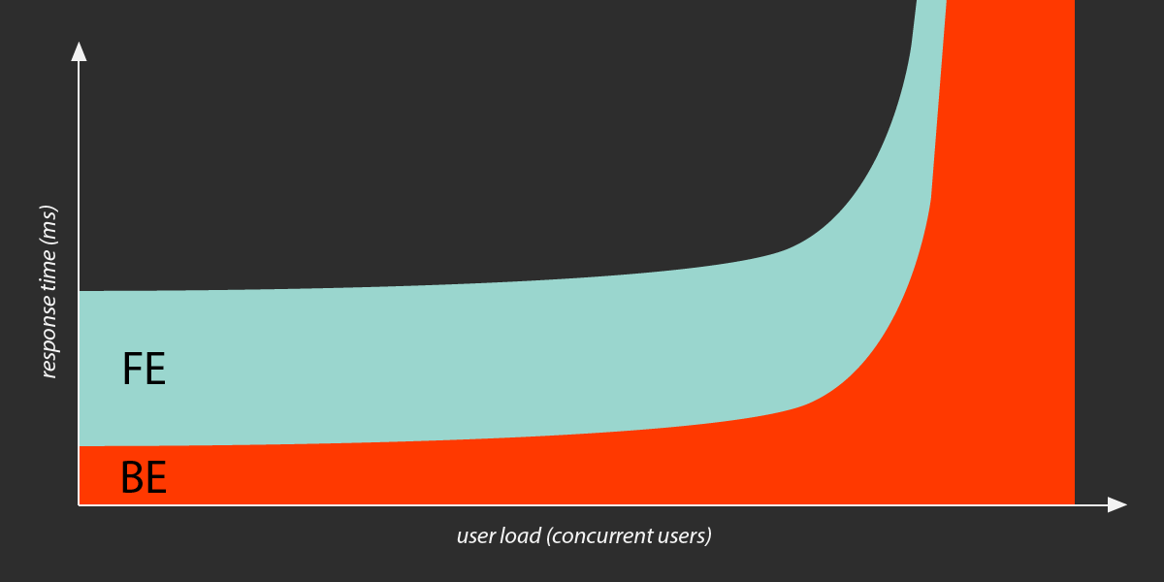
Website Performance – what it looks like
Not talking about page load speed – use Lighthouse or other to fine-tune that in a non-load environment
Talking about the performance of your site/app when multiple users try to use it at the same time
Image credit: https://loadster.app/guides/front-end-vs-back-end-performance/
Notes:
This is assuming relatively modern website design that revolves around using static elements (images, fonts, HTML) to build pages with API calls used to get data and to generate user action
In low load, Front-End and Back-End perform relatively the same. As load increases, Front-End remains steady – after all it's just a matter of sending out static content. The size of the network pipe and the web servers will be the limiting factor
But for back-end performance, once load becomes heavy, the actual performance is pretty much a wild guess. This is what we have to measure in this performance testing

Slide 6
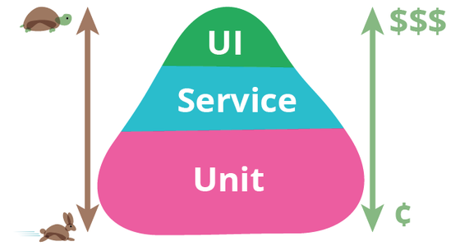
Performance Testing - How?
From previous slide, we will focus on the back-end performance, i.e. APIs/Service layer
Test APIs, as needed, at the
Service layer of the pyramid
Can (and should!) still do some
End to End/UI performance test
once APIs have proven performance
Image credit: https://martinfowler.com/bliki/TestPyramid.html
Notes:
If the API/Service level is performing poorly, what is even the point of testing the End to End scenario?

Slide 7
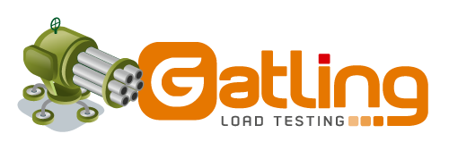


Open-Source Performance Test Tools
Gatling https://gatling.io
Locust https://locust.io
Taurus https://gettaurus.org
And many others, of course… Some comparisons:
https://www.blazemeter.com/blog/open-source-load-testing-tools-which-one-should-you-use
https://dzone.com/articles/how-to-easily-load-test-with-open-source-tools
Notes:
Load Testing tools were not generally well known a few years back (except by Performance Engineers), but with many good open-source tools appearing, there has been a democratization of these tools…
What they do: repeat the same calls with (hopefully) dynamic data following a certain simulation pattern decided beforehand and give a report about how your application responded to the barrage

Slide 8
Is this just changing a tool for another?
Isn’t this just moving from commercial performance test tools to open-source tools and there is still a steep learning curve to climb before doing performance testing?
In a sense, yes...
BUT, you could re-use your functional API tests essentially as-is for your performance testing and skip that steep learning curve of the new tool!
Karate (functional tests) + Gatling (performance tests)

Slide 9

Introduction to Karate
https://github.com/karatelabs/karate
Written in Java - tests do not require any Java knowledge
Tests are plain text using a simple BDD-like syntax (it is NOT BDD)
Fully supports JSON and XML natively
Can be extended with JavaScript and/or Java code
Out-of-the-box, it comes with:
Multithreaded Parallel test execution
Full support for data-driven testing, even using dynamic data
Beautiful HTML reports with easy-to-use debug information
Notes:
There is a standalone JAR for people that don’t even want to setup a Java project at all
Has many advanced features that are out of scope for this presentation, like easy creation of test doubles (mocks and all), and UI testing

Slide 10
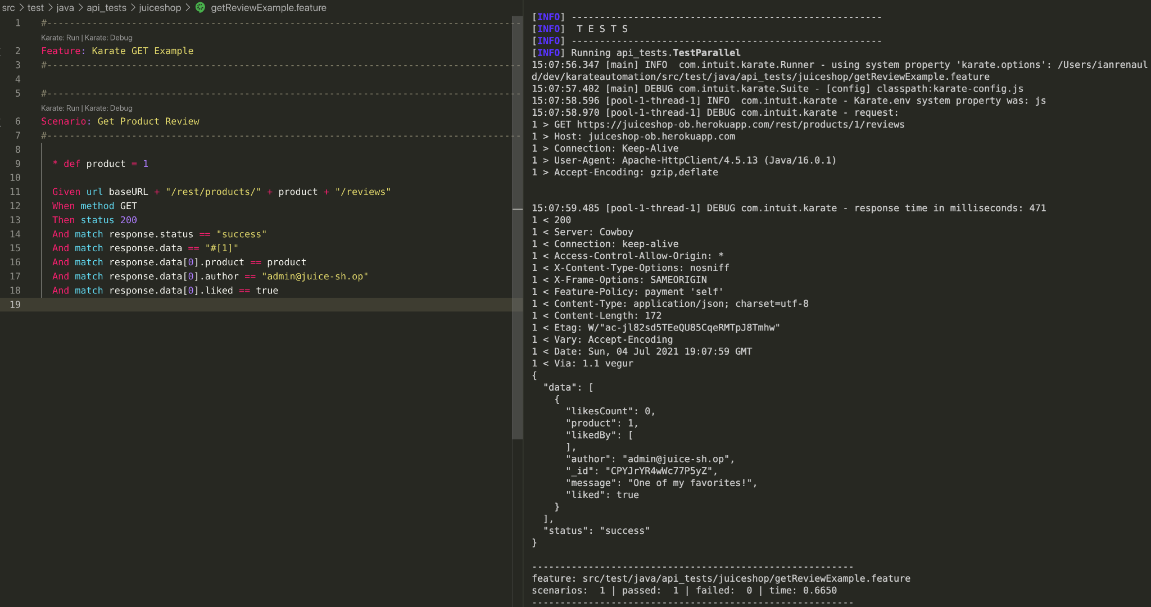
Karate Example: Simple GET
Notes:
Feature + Scenario keywords are used to structure tests like Cucumber (Karate no longer relies on Cucumber)
Given And When Then are the BDD-like keywords - you can skip them and just use *
The response of a request is automatically available in the "response" variable, use JSON paths or XPath from that point on to match or get your data
Powerful matching statements – makes schema verification a walk in the park compared to any other tool I've seen
Note the use of a global constant: baseURL in this example

Slide 11
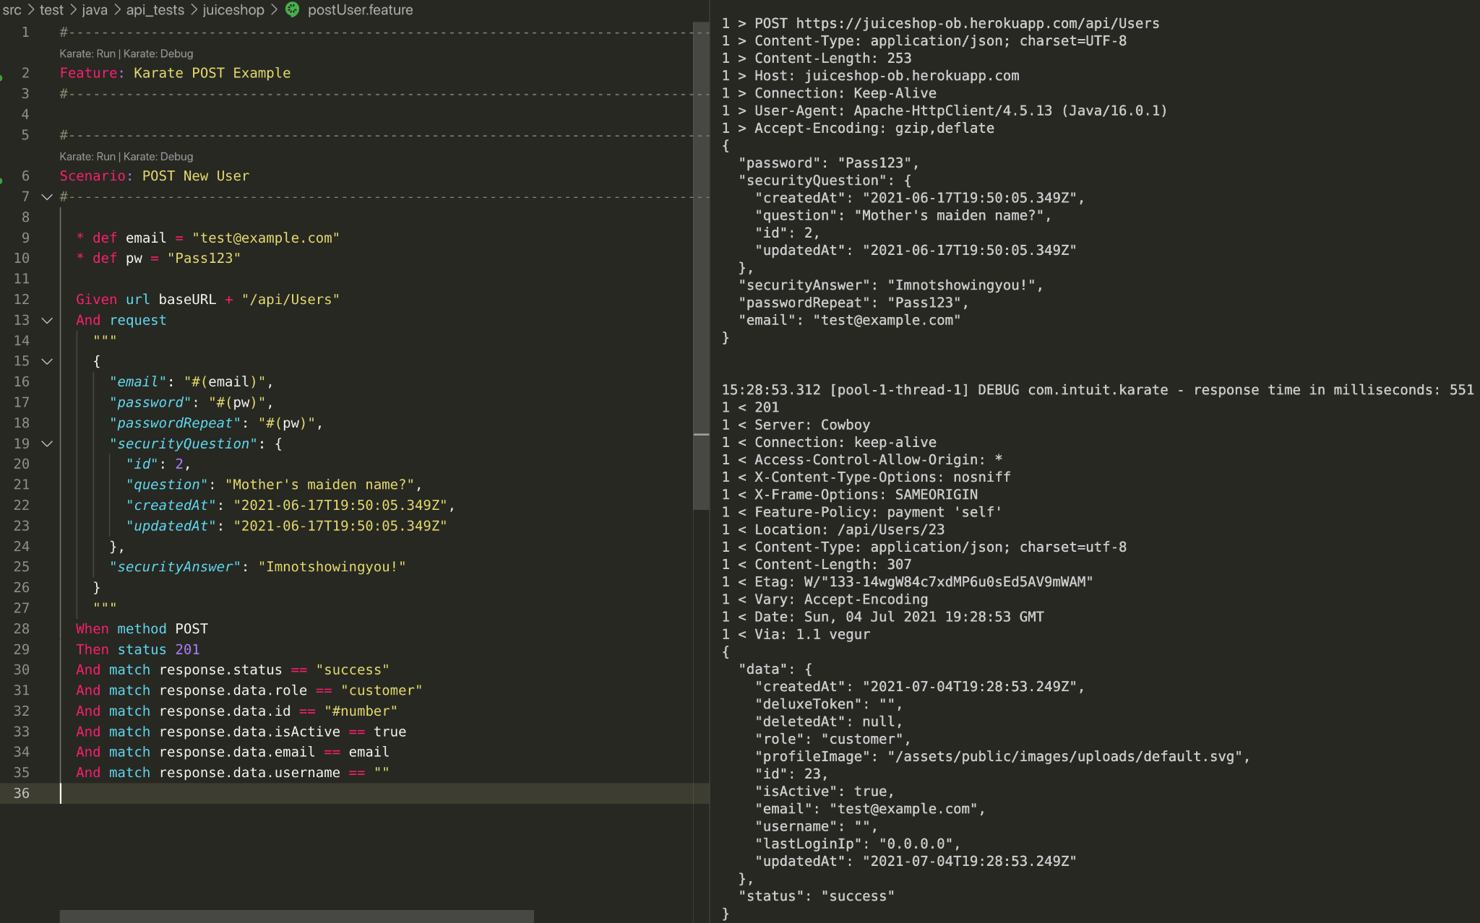
Karate Example: Simple POST
Notes:
Can write JSON and XML “as-is” in your tests directly or in a separate JSON or XML file
Variable substitution examples in the request

Slide 12
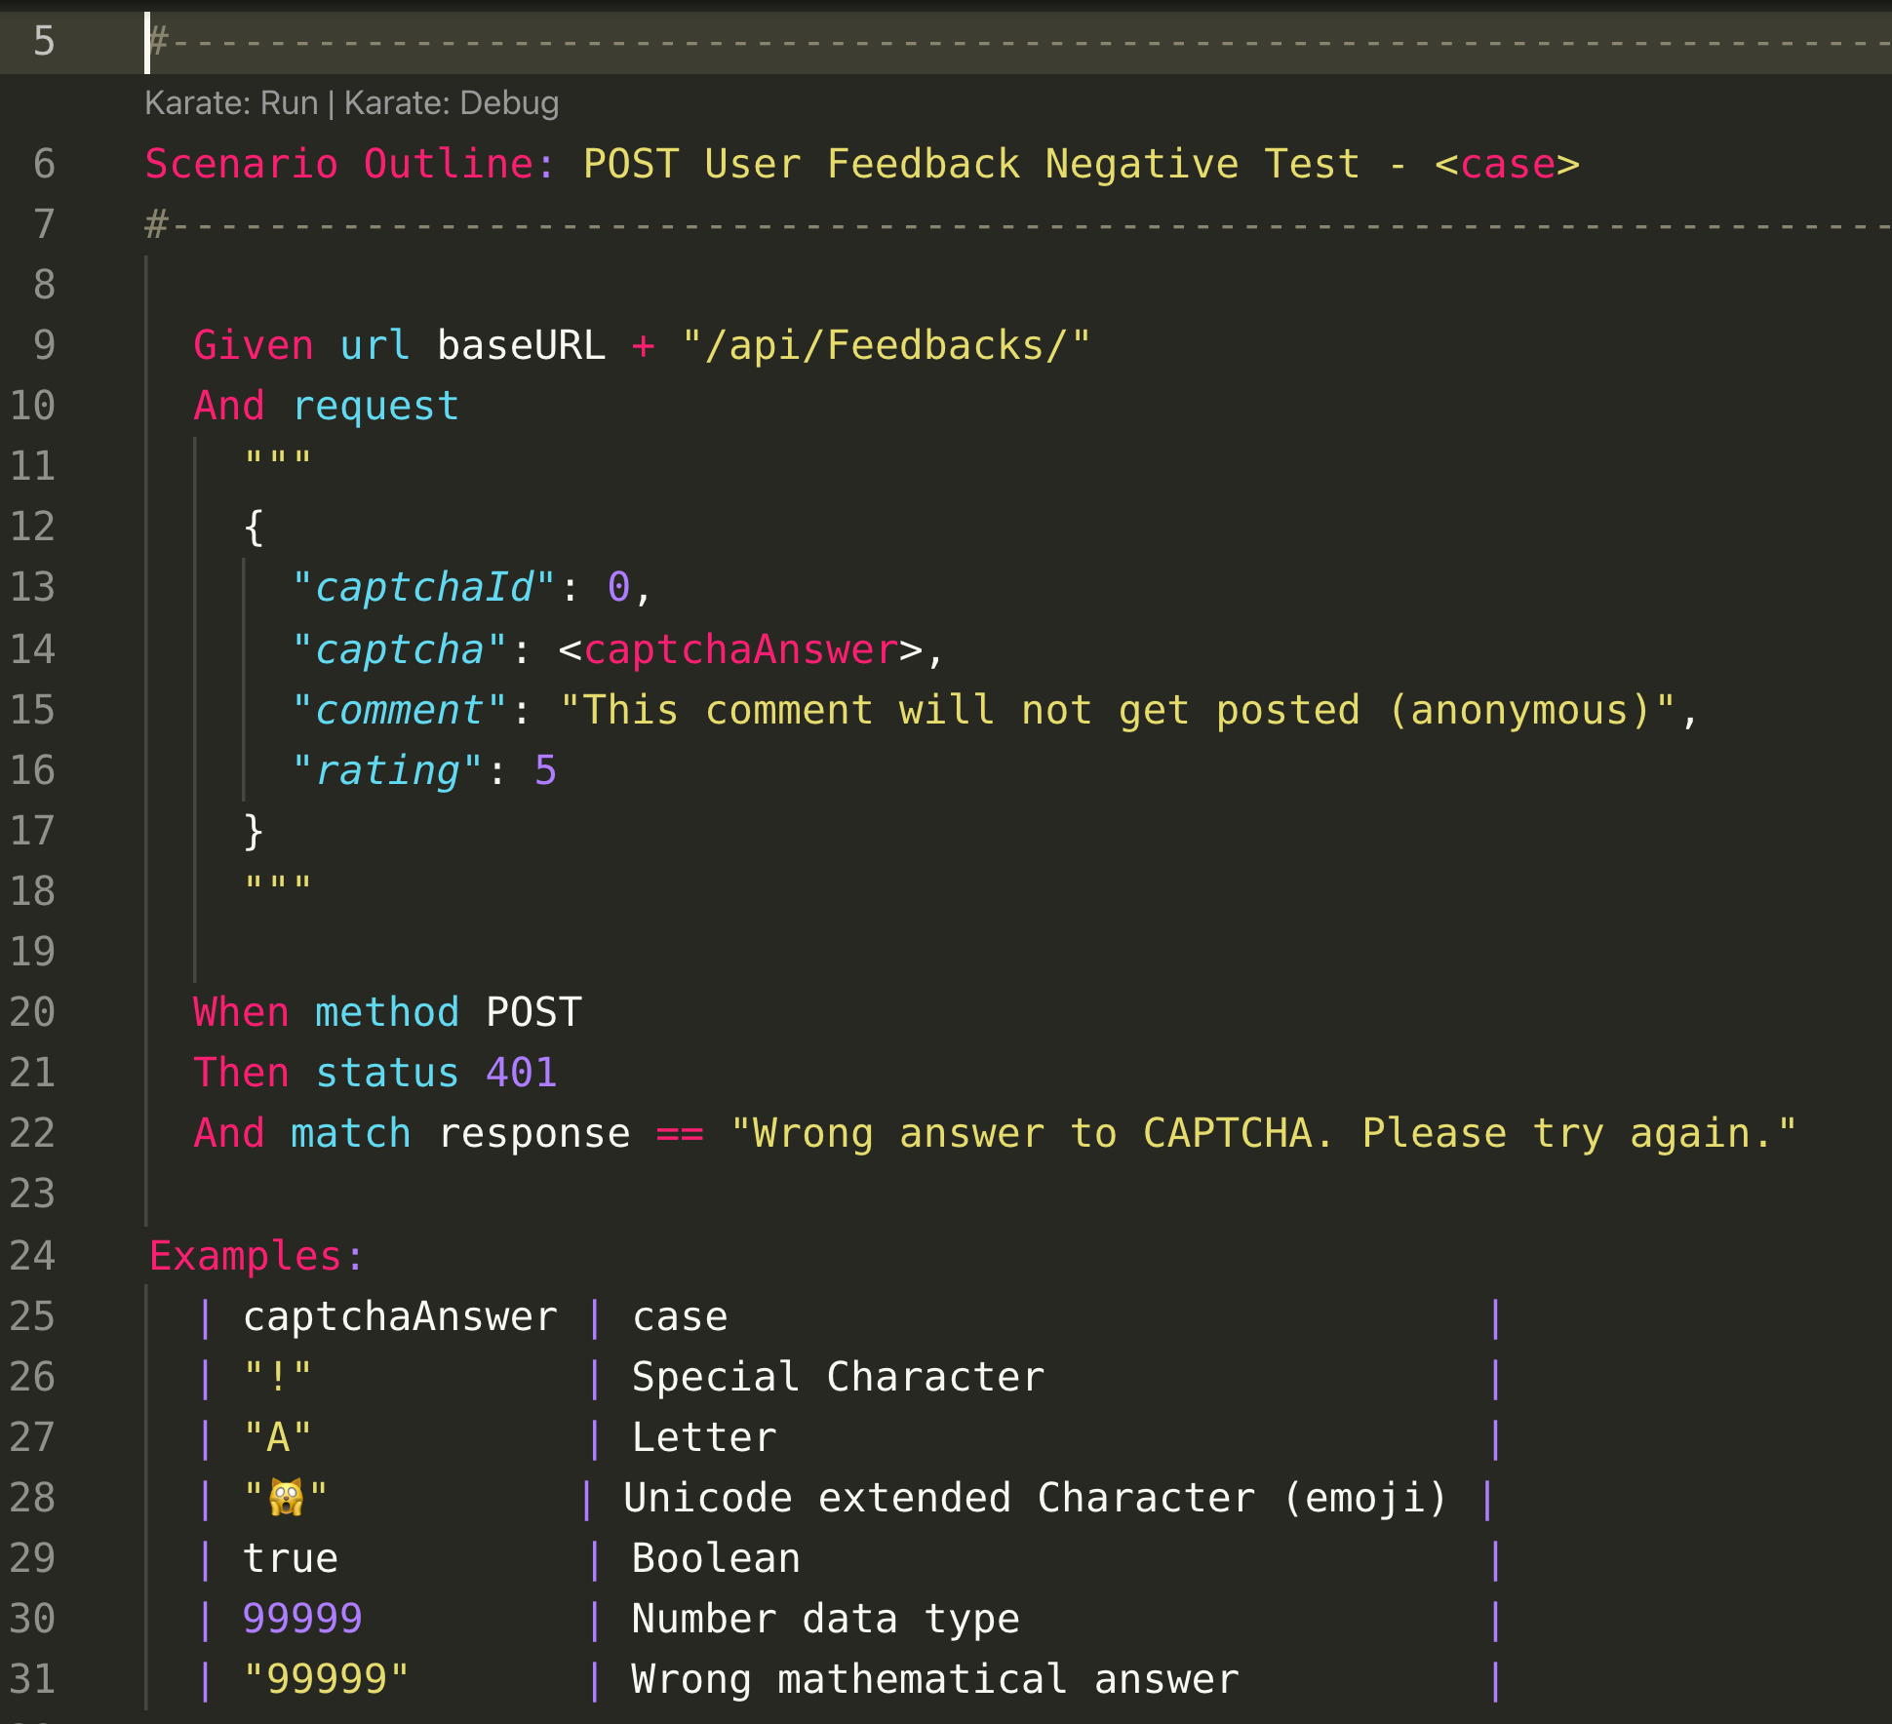
Karate Example: Advanced Example
Notes:
Each Karate Scenario is run in parallel - also each row of the Example table is run in parallel as well
Things I don’t have time to show: advanced matching, calling other features, easy response Schema validation plus test doubles built-in

Slide 13
Introduction to Gatling
https://gatling.io/ - Open Source and Enterprise versions available
Tests can be written in Scala and more recently Java and Kotlin
Generates nice HTML reports out of the box
Great documentation
But you don’t really need to know much about Gatling - it’s used mostly as the runner of existing Karate tests, but in a performance context!
Notes:
This is the old Gatling logo – I like it better than the new one
Basic template of Scala code provided in Karate-gatling integration project on Github - there is very little Scala knowledge required to have a working simulation
I knew nothing of Scala and managed it on my first try! There is no example (yet) on doing it in Java or Kotlin... I would still go with using Scala at this point even if you are more familiar with Java or Kotlin

Slide 14
Performance Testing - some context
From what we said earlier, we are interested in testing back-end (API) calls with a high level of load
Simulates a web site/application that is getting a lot of traffic by making tons of API requests (simulating individual users)
Possible to do manually, but doing so doesn’t scale (labor intensive, not repeatable). Performance testing needs to be automated
Recommended Solution: use existing automated Functionality tests (from Karate) with Gatling to transform them in Performance tests
Notes:
Basically: you already have your automated functionality tests. You now need to run many of them at the same time and measure the performance results.
Some minor adjustments to Karate tests might be needed, depending on the situation to accommodate Gatling
All you need to write in Gatling is the configuration of how many users (and when/how they make their calls) then let Gatling produce beautiful reports of how the application/web site responded to the barrage of users

Slide 15
Gatling User Injection Types
Supports Open and Closed Workload Models
Build your own injection profiles by leveraging different building blocks, such as:
nothingFor(duration): Pause for given duration
rampUsers(nbUsers) during(duration): Injects a given number of users with a linear ramp over the given duration
constantUsersPerSec(rate) during(duration): Injects users at a constant rate during given duration. Can be regular/random intervals
Tons more building blocks, see Gatling docs:
https://gatling.io/docs/gatling/reference/current/general/simulation_setup/#injection
Notes:
Closed systems are where you control the concurrent number of users. Pretty rare: call centers when all operators are busy, or a ticket ordering website where users are placed in a queue when system is at full capacity
Open systems are where you have no control on the concurrent number of users - we can simulate only the arrival rate of users - so pretty much everything else in the real world!
Basically, figure out the right simulation type and then figure out the number of "iterations" (users or whatever), rate (if applicable) and duration required to make a meaningful load test. If starting from scratch, nothing wrong with iterating over different values (starting small and increasing until the app shows problematic performance or behavior)

Slide 16
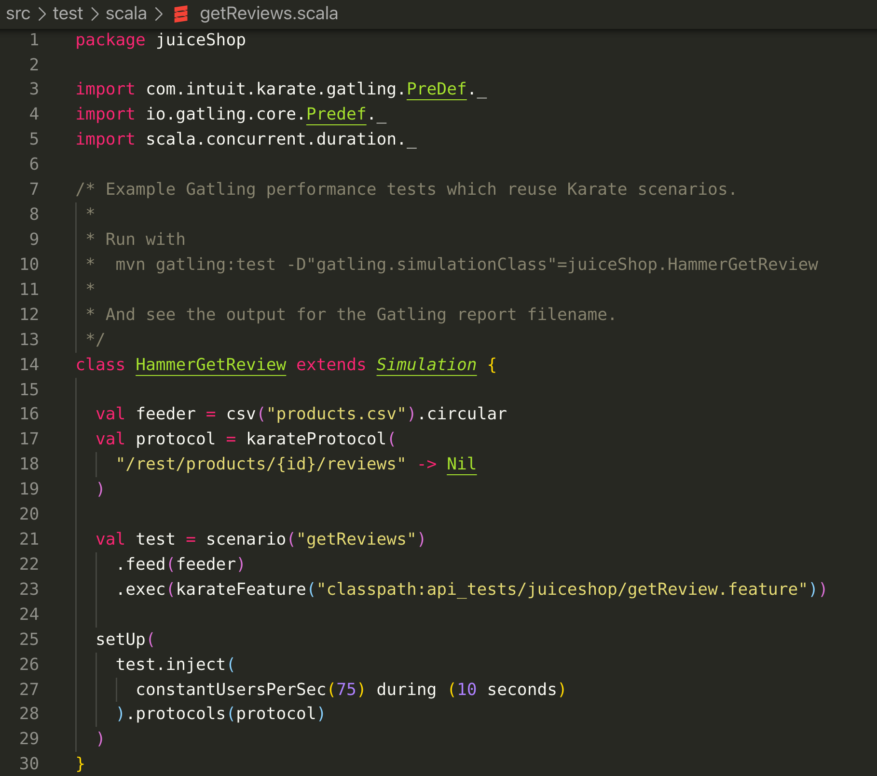
How to Integrate Karate with Gatling

Slide 17
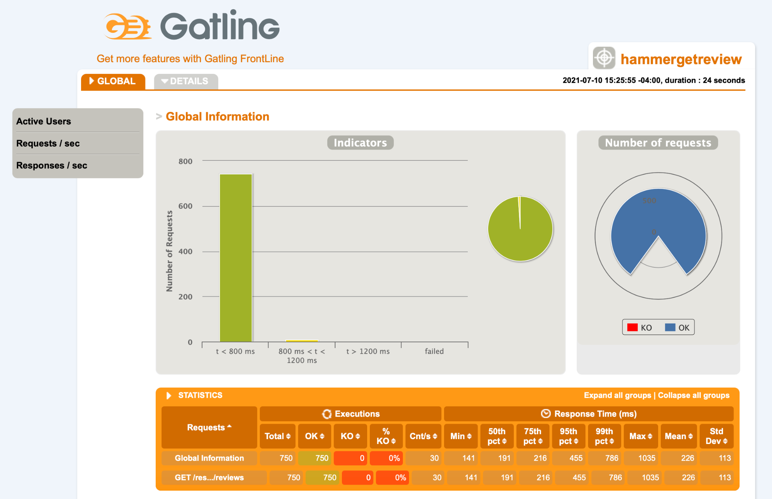
Gatling Report
Notes:
Gatling will output the test results on the CLI, but you don't get to see all the details. Basically you will get the table in orange we see above. The HTML reports are more exhaustive.
This is a super simple example of a single request. The Global tab shows the result for the entire simulation (all calls together), but obviously Gatling can measure all the individual requests at the same time and will provide (in the details tab) the results separated for each call
Don’t put any pause anywhere, you want to test the worst case scenario

Slide 18
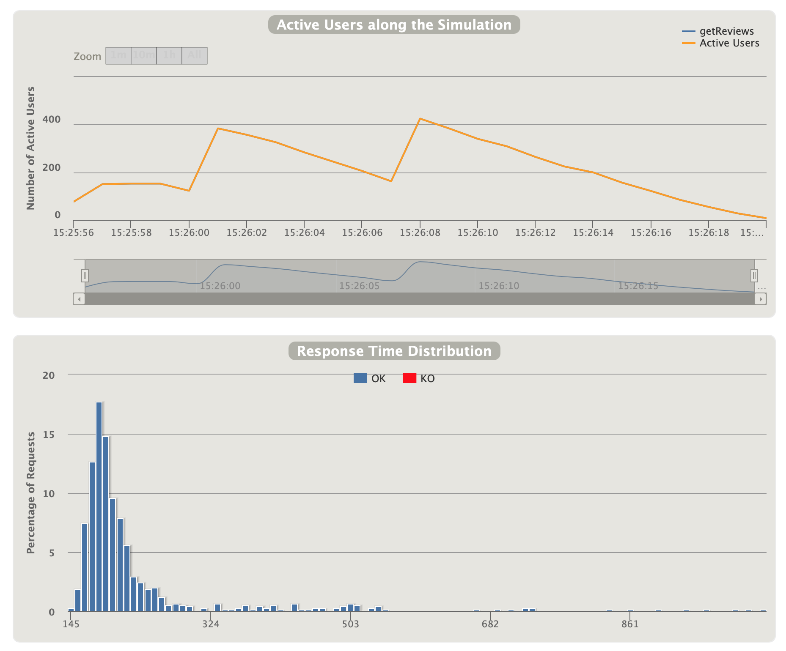
Gatling Report, continued

Slide 19
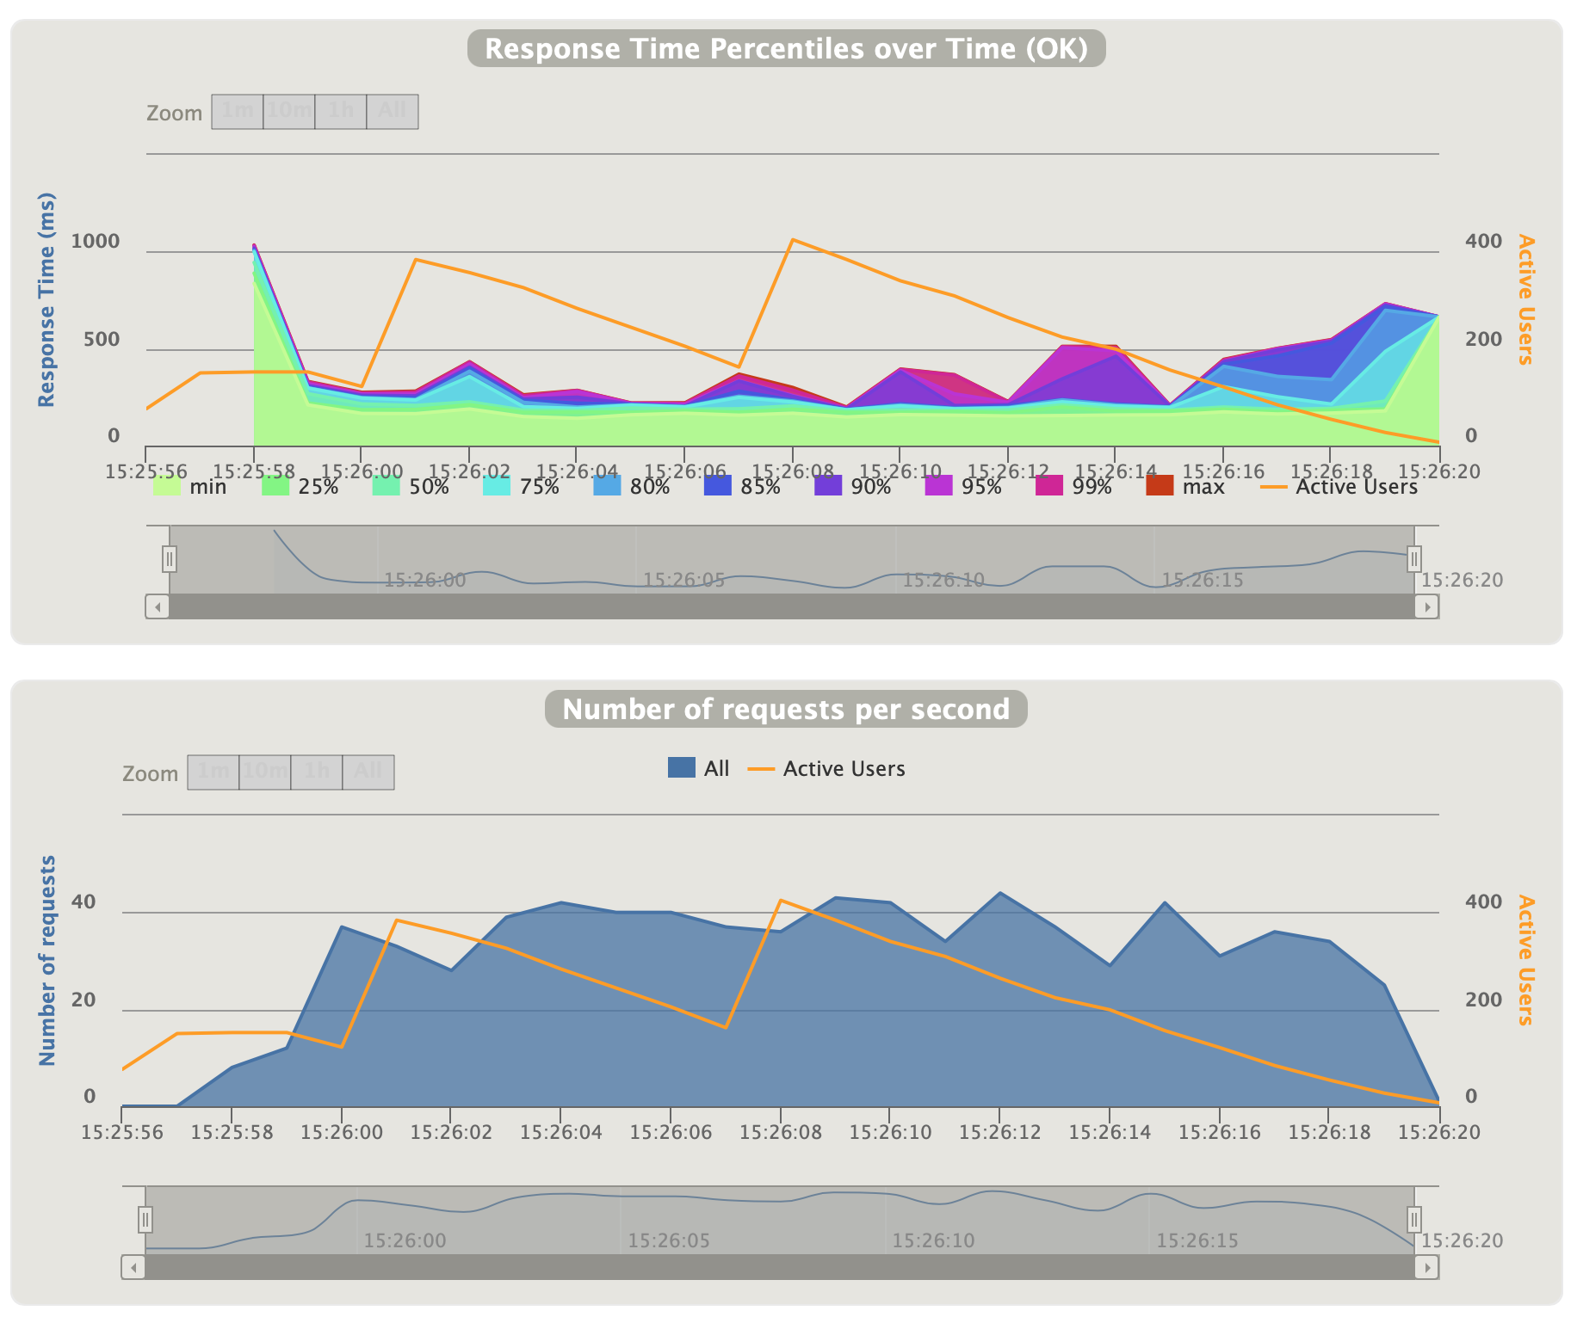
Gatling Report, continued

Slide 20
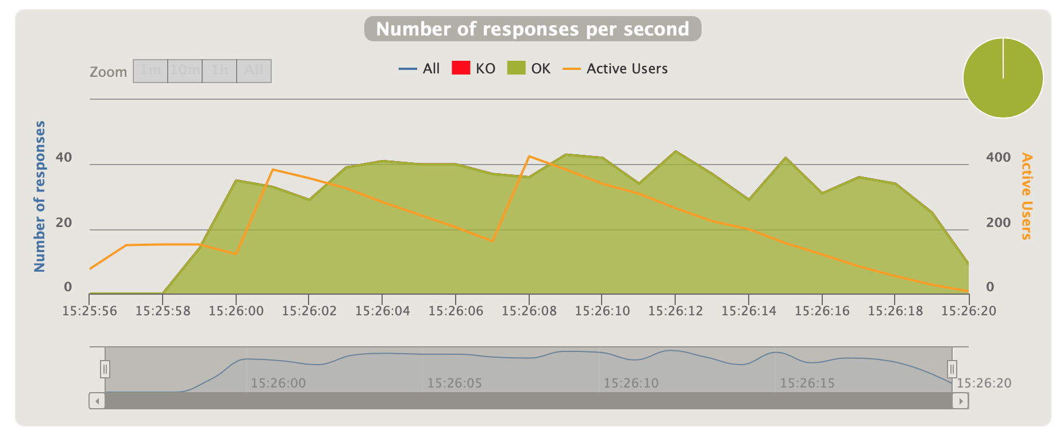
Gatling Report, continued

Slide 21
Testing Considerations
Pick the most appropriate way to provide input data (users, for example) to your Karate tests: dynamic, CSV/JSON file, not actually needed, etc.
Execute (and measure) only the API calls that are relevant: don’t waste time creating users if that is not what needs to be measured!
There should be a target result (SLA or other) - otherwise what are you measuring? How to judge if what is measured is good or not?
Notes:
Coming up with an adequate SLA is a topic for another day, but an example of the considerations to take are: an API that returns a single element should have a quicker performance target compared to an API returning a list of elements. For a list of elements, there should be a limited number of elements returned by the API, otherwise performance cannot be guaranteed (how could it if the list has like thousands of entries?). In other words, pagination should be implemented in the API results if the list of element can become too big.

Slide 22
Testing Considerations, continued
Strongly evaluate the environment you will be using to run the test. You don’t want to end up measuring the performance of the environment (especially not a lousy one) - you want to measure the performance of the application/API
If working remotely, be careful about where you have your clients. You might be measuring your network speed instead of the application's speed!
Notes:
This is the "science" part of Performance/Load Testing...
It’s possible to measure the performance locally, but carefully check that there are sufficient resources to run both the application under test (ideally, not the entire application - only the part that needs to be measured) and the clients causing the load on the application.
If not, it’s possible to do it over a network, but be careful that you are not measuring the network speed (whether it’s your home Internet speed, your wifi speed, the limitations imposed by VPNs, proxies, etc.) but measuring the application’s speed
It’s probably wise to colocate as much as possible the client and server being measured to minimize the network effect, but in the spirit of having everyone be able to do performance testing there is ample room to do basic performance checks before these considerations become the primary ones
Ideally make sure no one is using it at the same time as the performance testing is being done, etc.

Slide 23
Thank you!
Don’t hesitate to reach out for further discussions or questions!
Email: ianrenauld@gmail.com
Twitter: @QA_Ian
LinkedIn: https://www.linkedin.com/in/ian-renauld-a0455236
Notes:
That’s @QA_Ian on Twitter!

